Slide 1
Tutorials
How much charge is represented by 4,600 electrons?
Each electron has 1.602 ×10⁻¹⁹ C
Hence 4,600 electrons will have 1.602 ×10⁻¹⁹ ×4600= -7.369 ×10⁻¹⁶ C
2. The total charge entering a terminal is given by q= 5t sin4πt mc.
Calculate the current at t= 0.5 s
(5 sin 4πt + 20πt cos 4πt)
At, t= 0.5, I= 31.42 A
Home task: The total charge entering a terminal is given by q= (10 - 10e^{-2t}) mC
Calculate the current at t= 0.5 s

Slide 2
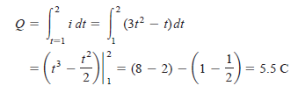
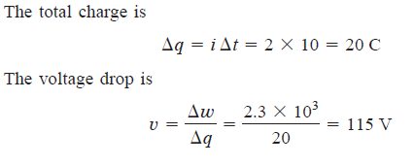
Tutorials
Determine the total charge entering a terminal between t= 1s and t= 2s . If the current passing the terminal is I = 3t² – t A
An energy source forces a constant current of 2 A for 10 s to flow through a lightbulb. If 2.3 kJ is given off in the form of light and heat energy, calculate the voltage drop across the bulb.

